Slide 1

TRAINING SESSION ON FUNDAMENTALS OF DEEP LEARNING
Presented by:
Dr. Bunil Kumar Balabantaray Assistant Professor
Department of Computer Science and Engineering, NATIONAL INSTITUTE OF TECHNOLOGY MEGHALAYA
Anmol Gautam, Swastik Jena (Member of AI Research Group,NIT Meghalaya)

Slide 2

AGENDA
INTRODUCTION
DEFINITION
HISTORY
PERCEPTRON MODEL
FORWARD PROPOGATION
BACKWARD PROPOGATION
LOSS
OPTIMIZER
HANDS ON SESSION

Slide 3
AGENDA
INTRODUCTION
DEFINITION
HISTORY
PERCEPTRON MODEL
FORWARD PROPOGATION
BACKWARD PROPOGATION
LOSS
OPTIMIZER
HANDS ON SESSION
Deep Learning is a programming paradigm
Extract and transform data
Training vs being explicitly programmed
Learn by experience
Rule
+
Data
Answers
Data
+
Answers
Rules

Slide 4
AGENDA
INTRODUCTION
DEFINITION
HISTORY
PERCEPTRON MODEL
FORWARD PROPOGATION
BACKWARD PROPOGATION
LOSS
OPTIMIZER
HANDS ON SESSION
Therefore, ML model is trained and explicitly programmed.
Learning is that part where based on inputs and expected output we tune the model i.e. update the parameters.
Ultimately, we are transforming data to derive meaningful representations
This meaningful representation comes from a finites set of possible solutions called hypothesis space.

Slide 5
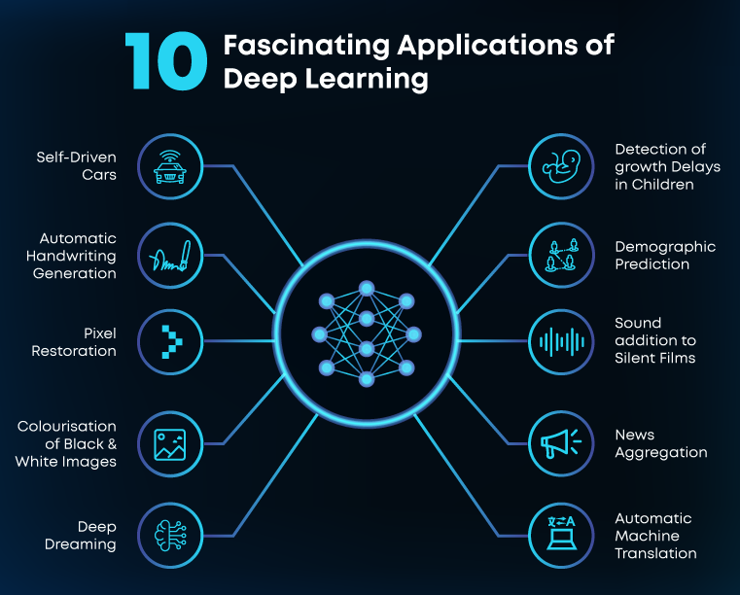
AGENDA
INTRODUCTION
DEFINITION
HISTORY
PERCEPTRON MODEL
FORWARD PROPOGATION
BACKWARD PROPOGATION
LOSS
OPTIMIZER
HANDS ON SESSION

Slide 6
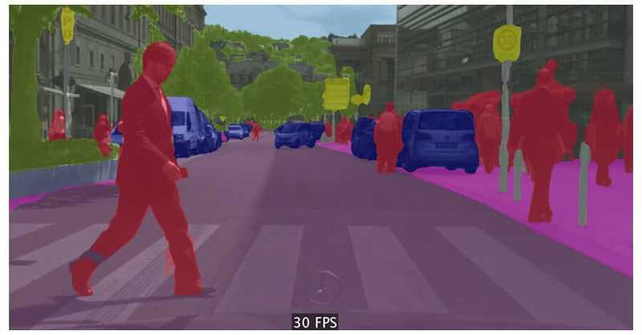
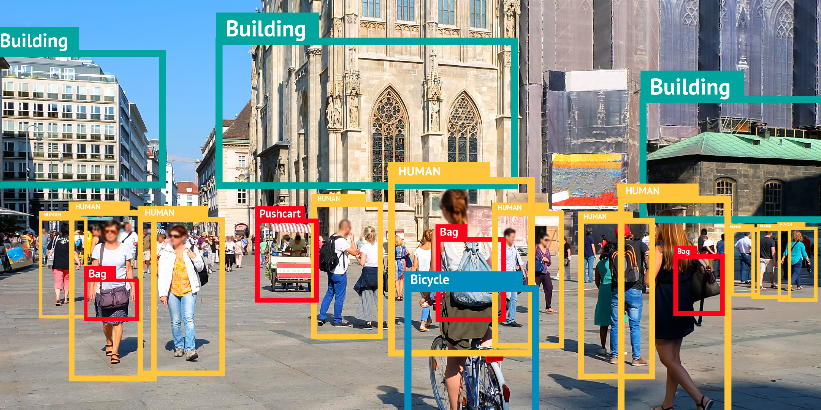
AGENDA
INTRODUCTION
DEFINITION
HISTORY
PERCEPTRON MODEL
FORWARD PROPOGATION
BACKWARD PROPOGATION
LOSS
OPTIMIZER
HANDS ON SESSION

Slide 7
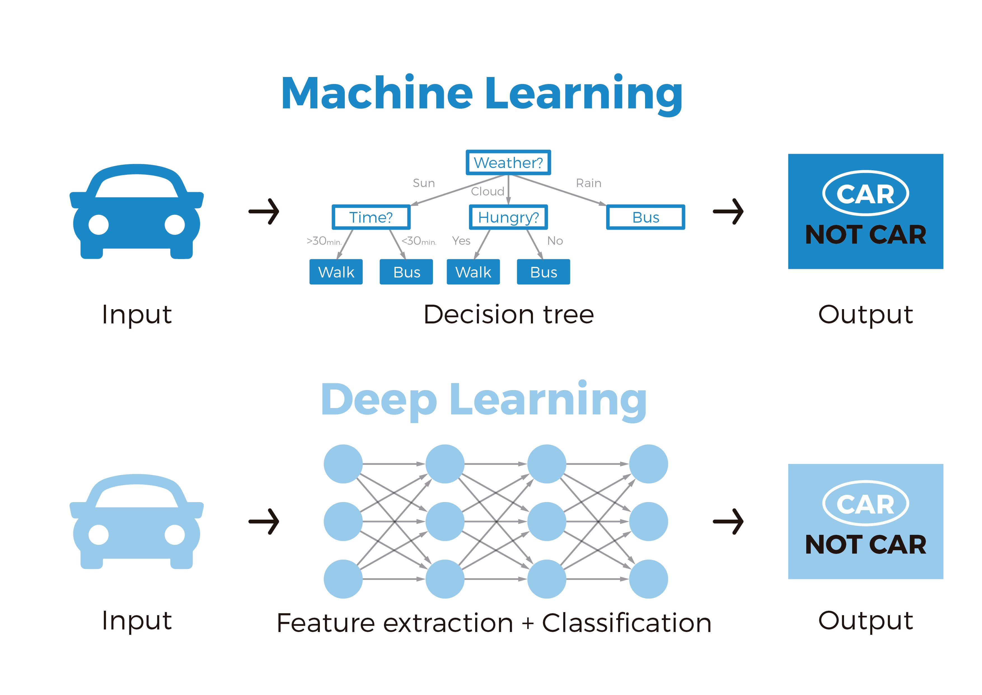
AGENDA
INTRODUCTION
DEFINITION
HISTORY
PERCEPTRON MODEL
FORWARD PROPOGATION
BACKWARD PROPOGATION
LOSS
OPTIMIZER
HANDS ON SESSION
Machine learning is the science of getting computers to act without being explicitly programmed.
Deep learning is a machine learning technique that teaches computers to do what comes naturally to humans: learn by example.

Slide 8
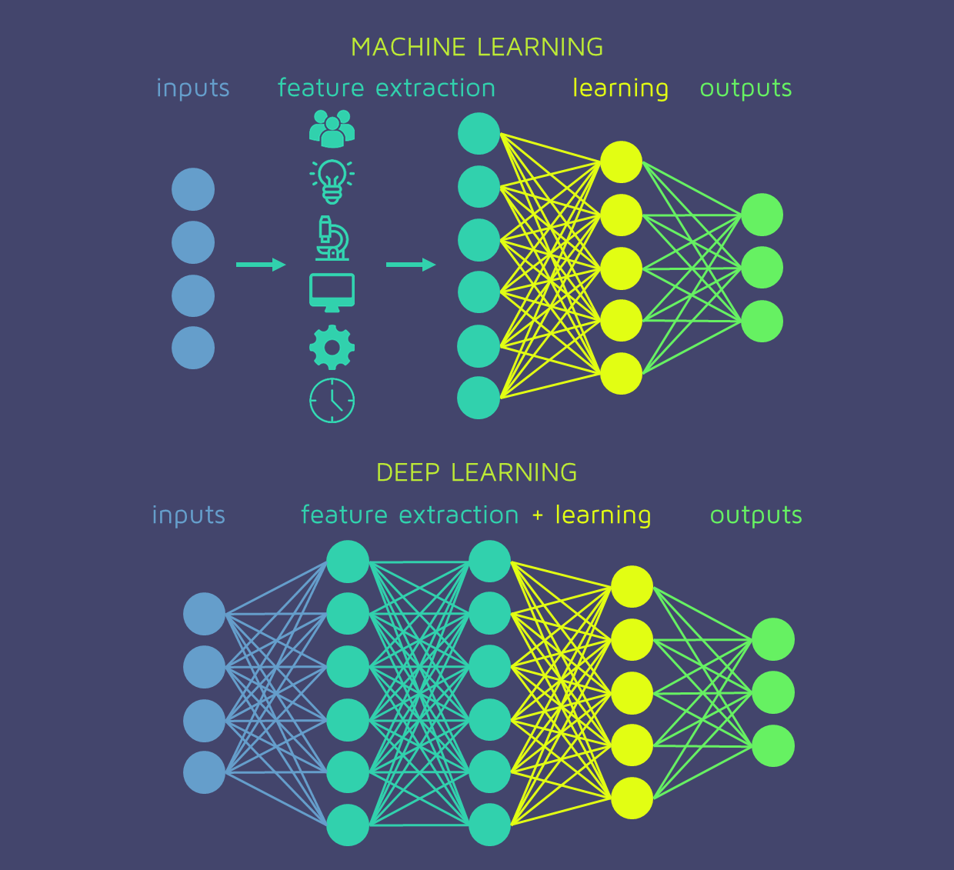
AGENDA
INTRODUCTION
DEFINITION
HISTORY
PERCEPTRON MODEL
FORWARD PROPOGATION
BACKWARD PROPOGATION
LOSS
OPTIMIZER
HANDS ON SESSION
Deep learning requires large amounts of labeled data
Deep learning requires substantial computing power

Slide 9
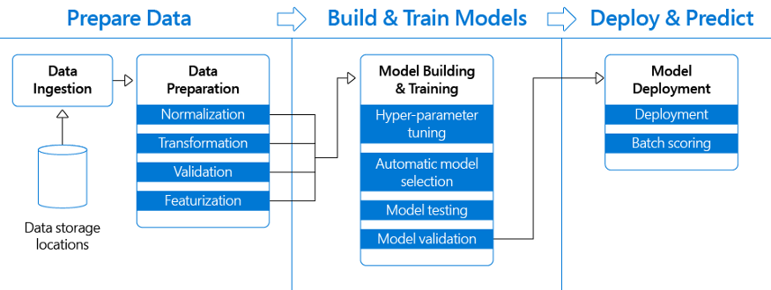
AGENDA
INTRODUCTION
DEFINITION
HISTORY
PERCEPTRON MODEL
FORWARD PROPOGATION
BACKWARD PROPOGATION
LOSS
OPTIMIZER
HANDS ON SESSION

Slide 10
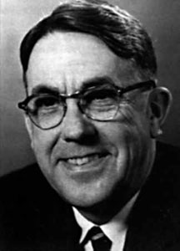
AGENDA
INTRODUCTION
DEFINITION
HISTORY
PERCEPTRON MODEL
FORWARD PROPOGATION
BACKWARD PROPOGATION
LOSS
OPTIMIZER
HANDS ON SESSION
Arthur Samuel
Worked on a different way to get
computers to do a job.
“Programming a computer for such computations is, at best, a difficult task, not primarily because of any inherent complexity in the computer itself but, rather, because of the need to spell out every minute step of the process in the most exasperating detail. Computers, as any programmer will tell you, are giant morons, not giant brains”

Slide 11
AGENDA
INTRODUCTION
DEFINITION
HISTORY
PERCEPTRON MODEL
FORWARD PROPOGATION
BACKWARD PROPOGATION
LOSS
OPTIMIZER
HANDS ON SESSION
“Suppose we arrange for some automatic means of testing the effectiveness of any current weight assignment in terms of actual performance and provide a mechanism for altering the weight assignment so as to maximize the performance. We need not go into the details of such a procedure to see that it could be made entirely automatic and to see that a machine so programmed would learn from its experience”

Slide 12
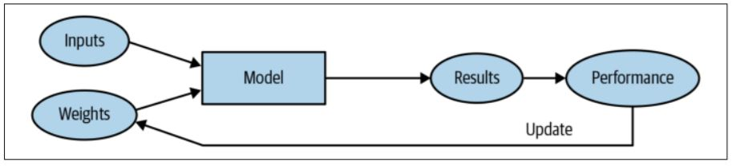
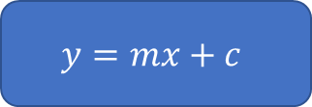
AGENDA
INTRODUCTION
DEFINITION
HISTORY
PERCEPTRON MODEL
FORWARD PROPOGATION
BACKWARD PROPOGATION
LOSS
OPTIMIZER
HANDS ON SESSION
parameters
$$y=mx+c$$
output
input

Slide 13
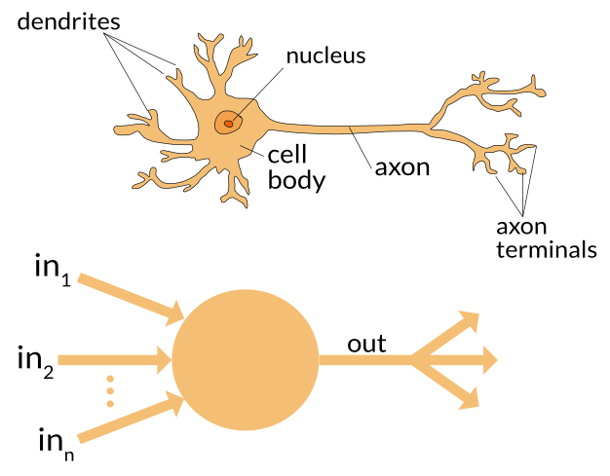
AGENDA
INTRODUCTION
DEFINITION
HISTORY
PERCEPTRON MODEL
FORWARD PROPOGATION
BACKWARD PROPOGATION
LOSS
OPTIMIZER
HANDS ON SESSION

Slide 14
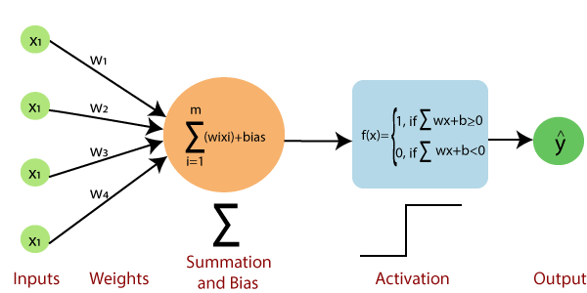
AGENDA
INTRODUCTION
DEFINITION
HISTORY
PERCEPTRON MODEL
FORWARD PROPOGATION
BACKWARD PROPOGATION
LOSS
OPTIMIZER
HANDS ON SESSION

Slide 15
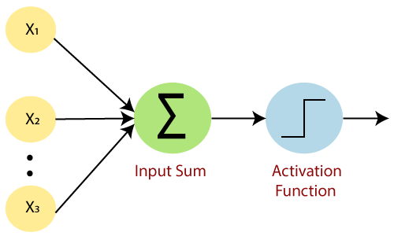
AGENDA
INTRODUCTION
DEFINITION
HISTORY
PERCEPTRON MODEL
FORWARD PROPOGATION
BACKWARD PROPOGATION
LOSS
OPTIMIZER
HANDS ON SESSION
Weights represents dimension or strength of the connection between units.
Bias represents an additional parameter which task is to modify the output along with the weighted sum of the input to the other neuron
Activation Function calculates a weighted sum and further adding bias with it to give the result.

Slide 16
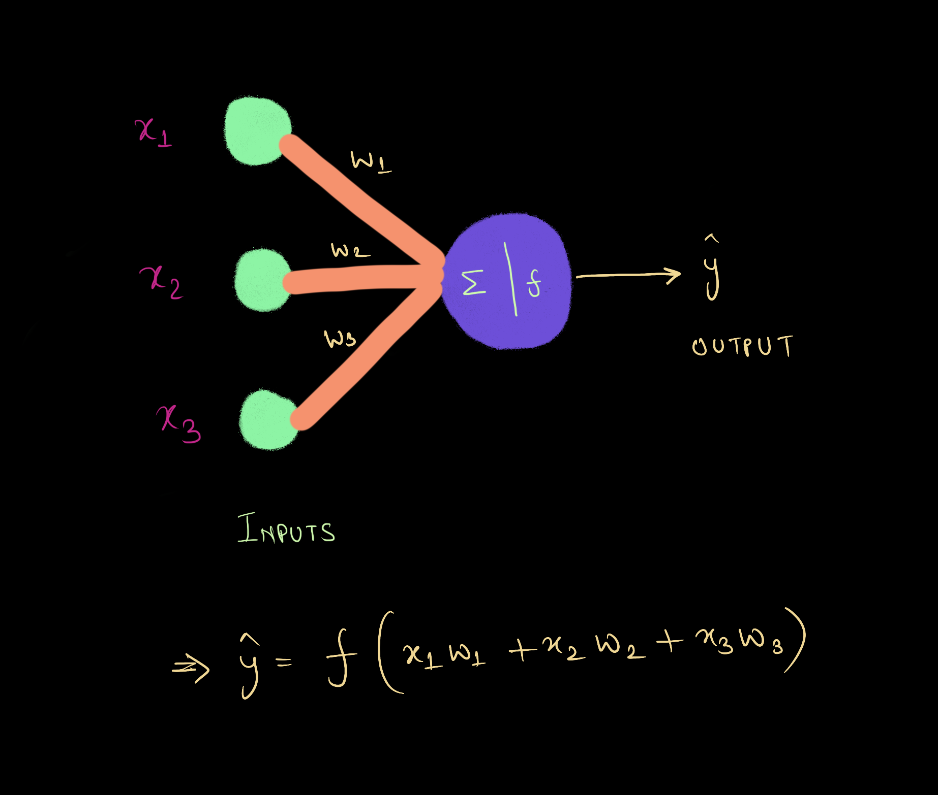
AGENDA
INTRODUCTION
DEFINITION
HISTORY
PERCEPTRON MODEL
FORWARD PROPOGATION
BACKWARD PROPOGATION
LOSS
OPTIMIZER
HANDS ON SESSION

Slide 17

AGENDA
INTRODUCTION
DEFINITION
HISTORY
PERCEPTRON MODEL
FORWARD PROPOGATION
BACKWARD PROPOGATION
LOSS
OPTIMIZER
HANDS ON SESSION

Slide 18
AGENDA
INTRODUCTION
DEFINITION
HISTORY
PERCEPTRON MODEL
FORWARD PROPOGATION
BACKWARD PROPOGATION
LOSS
OPTIMIZER
HANDS ON SESSION
Computational Graph

Slide 19

AGENDA
INTRODUCTION
DEFINITION
HISTORY
PERCEPTRON MODEL
FORWARD PROPOGATION
BACKWARD PROPOGATION
LOSS
OPTIMIZER
HANDS ON SESSION

Slide 20

AGENDA
INTRODUCTION
DEFINITION
HISTORY
PERCEPTRON MODEL
FORWARD PROPOGATION
BACKWARD PROPOGATION
LOSS
OPTIMIZER
HANDS ON SESSION

Slide 21
AGENDA
INTRODUCTION
DEFINITION
HISTORY
PERCEPTRON MODEL
FORWARD PROPOGATION
BACKWARD PROPOGATION
LOSS
OPTIMIZER
HANDS ON SESSION
This function will essentially calculate how poorly our model is performing by comparing what the model is predicting with the actual value it is supposed to output. If predicted output is very far off from actual output, the Loss value will be very high. However if both values are almost similar, the Loss value will be very low. Hence we need to keep a loss function which can penalize a model effectively while it is training on a dataset.

Slide 22
AGENDA
INTRODUCTION
DEFINITION
HISTORY
PERCEPTRON MODEL
FORWARD PROPOGATION
BACKWARD PROPOGATION
LOSS
OPTIMIZER
HANDS ON SESSION
Goal is to minimize the loss function. Why?
Well, because we want to get as accurate result as we can without memorizing the data.
How to minimize?
MATHEMATICS

Slide 23
AGENDA
INTRODUCTION
DEFINITION
HISTORY
PERCEPTRON MODEL
FORWARD PROPOGATION
BACKWARD PROPOGATION
LOSS
OPTIMIZER
HANDS ON SESSION
Lets see a story NOW……..
Friend A
Says
I have a function that I want to minimize such that I find those values for its variables
For which
This function gives
Minimum value
Friend B
Says
No worries Dude
If your function is differentiable
Then I have a tool that can tell you in which direction you can move to
Get these minimum values.

Slide 24
AGENDA
INTRODUCTION
DEFINITION
HISTORY
PERCEPTRON MODEL
FORWARD PROPOGATION
BACKWARD PROPOGATION
LOSS
OPTIMIZER
HANDS ON SESSION
Lets see a story NOW……..
LOSS Function
Gradient Descent

Slide 25
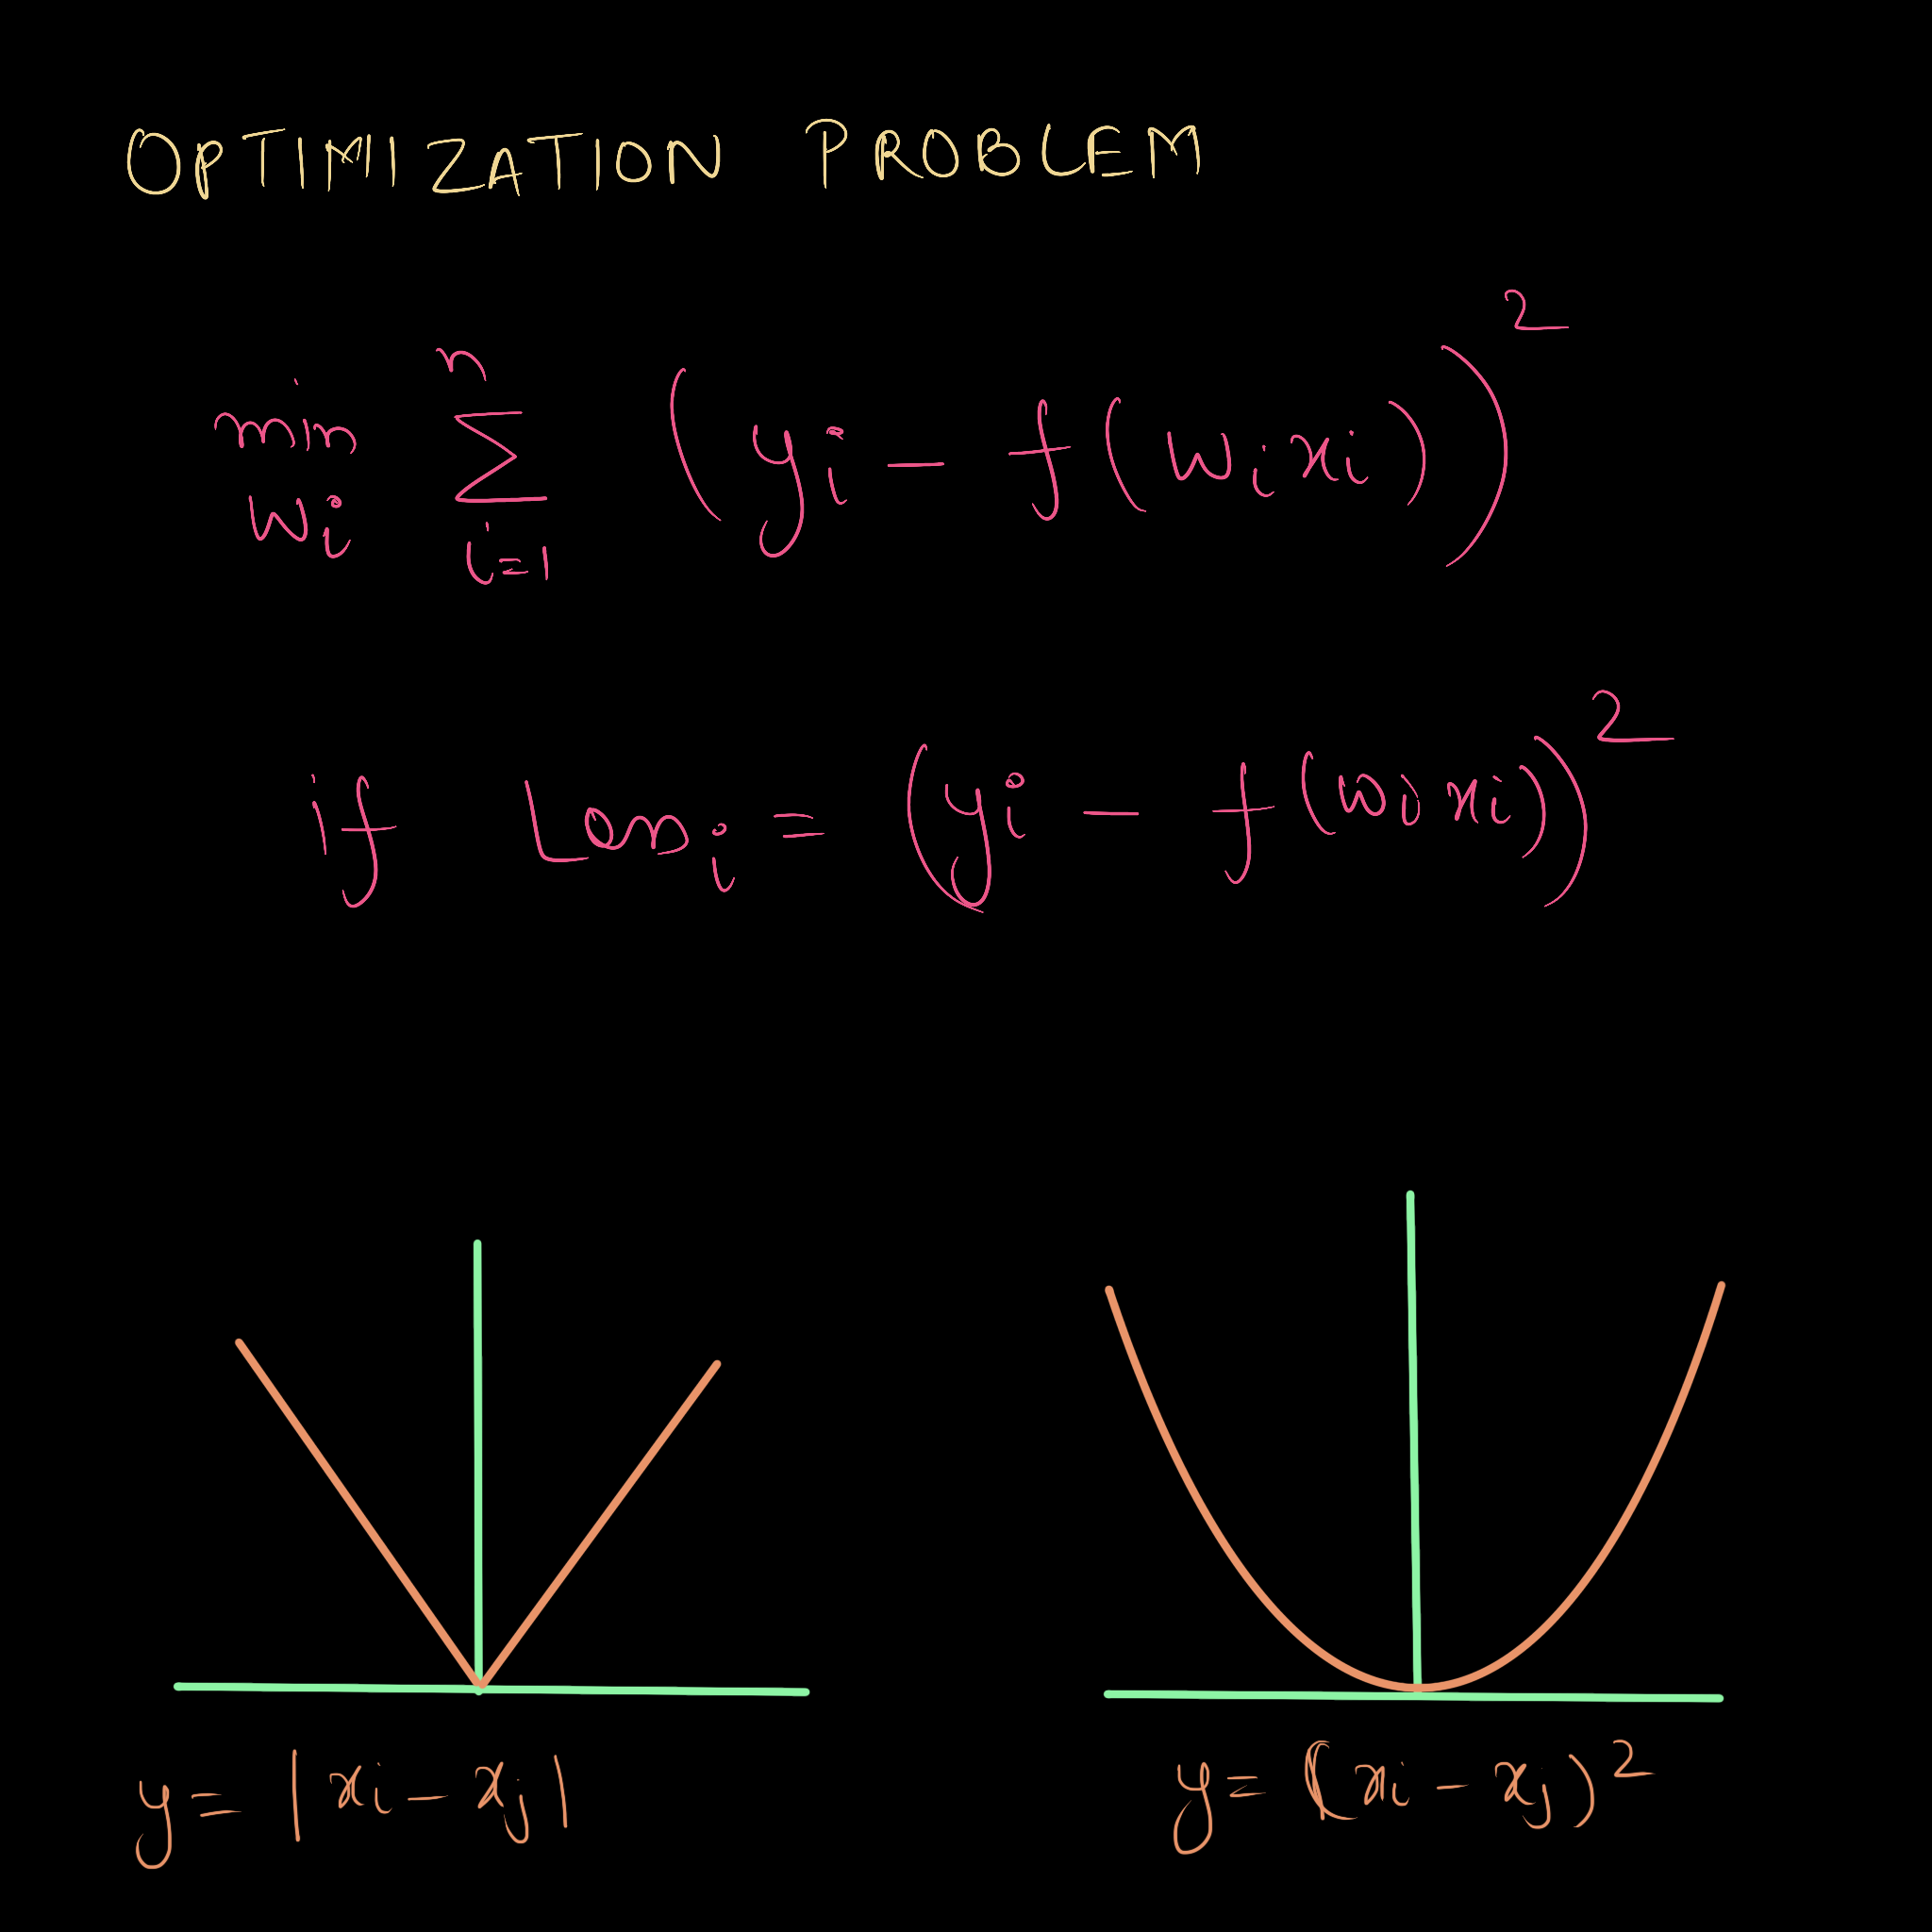
AGENDA
INTRODUCTION
DEFINITION
HISTORY
PERCEPTRON MODEL
FORWARD PROPOGATION
BACKWARD PROPOGATION
LOSS
OPTIMIZER
HANDS ON SESSION

Slide 26
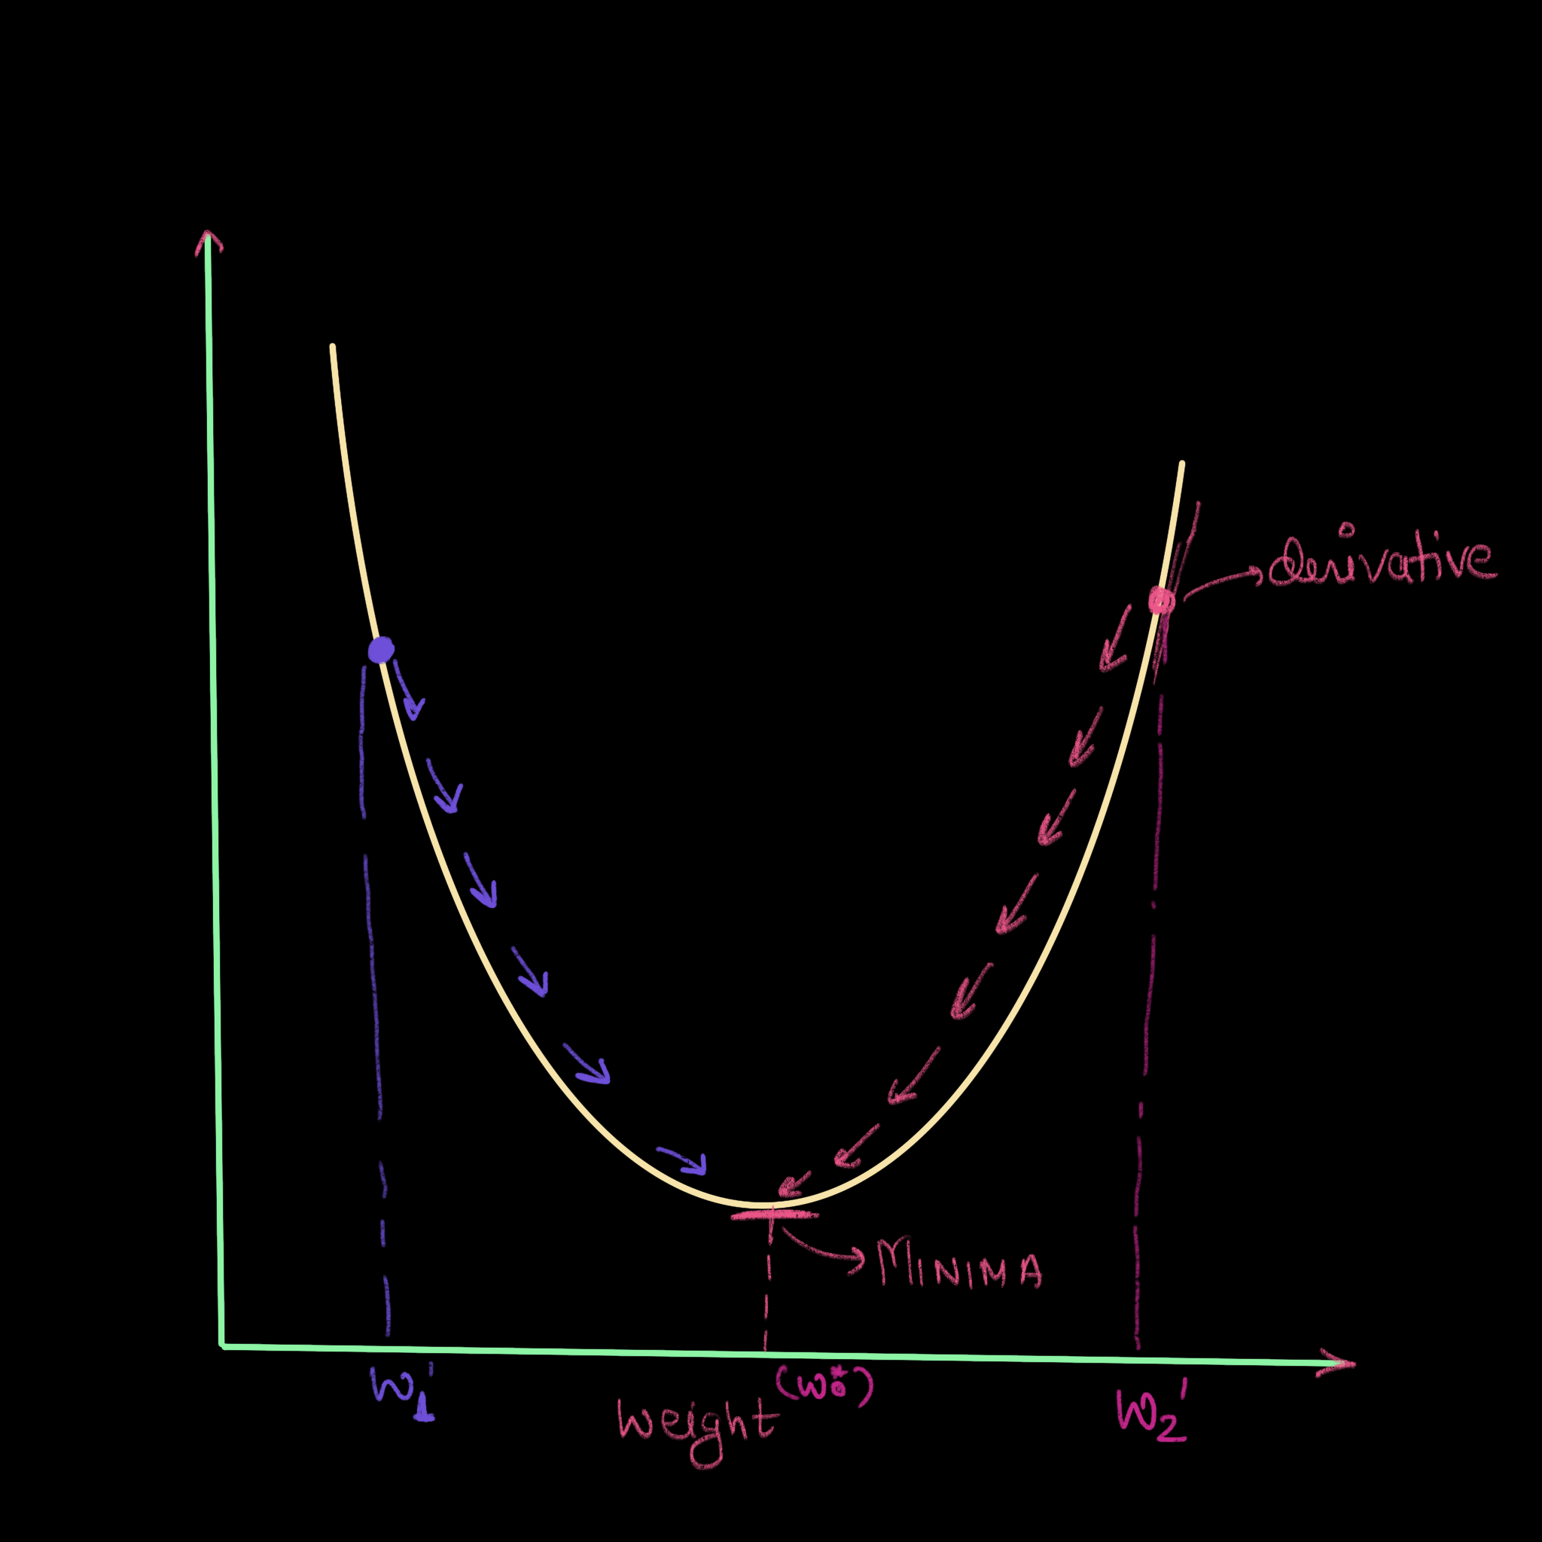
AGENDA
INTRODUCTION
DEFINITION
HISTORY
PERCEPTRON MODEL
FORWARD PROPOGATION
BACKWARD PROPOGATION
LOSS
OPTIMIZER
HANDS ON SESSION

Slide 27
THANK YOU….!

